Slide 1
Doctor Appointment System
This system allows Patients to book & get consultations with the doctors
Made by:-
Sudarshan Sinha(2305103140031)
Krishna Shankar(2305103140018)
Suparna Das(2305103140032)

Slide 2
INTRODUCTION:
The Doctor Appointment Management System is an online platform designed to simplify the process of scheduling and managing appointments between doctors and patients. This system provides a user-friendly interface that enables patients to search for and book appointments with doctors based on specialty, and availability. The system also allows doctors to manage their schedules and availability, review patient information, and accept or reject appointment requests.
Overall, the Doctor Appointment Management System is designed to improve access to healthcare services and simplify the appointment scheduling process for both patients and doctors. By providing an easy-to-use platform, this system can help increase patient satisfaction and improve the efficiency of healthcare services.

Slide 3
Requirement Gathering and analysis
Explanation of the requirement gathering and analysis process. Importance of understanding stakeholders' needs and expectations.
Identifying Stakeholders: List of stakeholders including doctors, medical staff, administrative personnel, and patients. Description of their roles, responsibilities, and expectations.
Eliciting Requirements: Techniques used such as interviews, surveys, and focus groups. Key features identified including appointment scheduling, patient registration, and notifications.
Analyzing Requirements: Organization and prioritization of requirements based on importance and feasibility. Ensuring clarity, conciseness, and unambiguity of requirements.
Documenting Requirements: Creation of a detailed requirements specification document. Use of use cases, user stories, and wireframes to illustrate system functionality.
Reviewing and Validating Requirements: Stakeholder review and validation process to ensure accuracy and completeness. Incorporation of feedback and confirmation of stakeholder satisfaction.
Managing Requirements Changes: Establishment of a process for managing changes throughout the project lifecycle. Implementation of a system for tracking and documenting changes. By presenting a comprehensive feasibility study and requirement gathering & analysis plan, stakeholders will gain a clear understanding of the project's potential success and how their needs will be addressed.

Slide 4
Advantages:
Efficiency: Streamlines the appointment scheduling process, reducing wait times for patients and optimizing the utilization of doctor's time. Allows patients to book appointments at their convenience, without the need for phone calls or in-person visits.
Improved Access to Care: Enables patients to access healthcare services more easily, particularly for non-urgent appointments. Increases flexibility by offering online booking options outside of traditional office hours.
Reduced Administrative Burden: Automates administrative tasks such as appointment scheduling, reminder notifications, and patient record management, freeing up staff time for more critical tasks. Minimizes errors associated with manual appointment scheduling and record-keeping.
Enhanced Patient Experience: Provides patients with greater control over their healthcare by allowing them to choose appointment times and healthcare providers based on their preferences. Sends automated reminders to patients, reducing the likelihood of missed appointments and improving adherence to treatment plans.
Data Analysis and Reporting: Generates valuable data on appointment volumes, patient demographics, and appointment outcomes, which can be used to optimize scheduling, resource allocation, and service delivery. Facilitates reporting and analysis of key performance indicators to identify areas for improvement and measure the effectiveness of healthcare services.

Slide 5
Disadvantages:
Technological Barriers: Requires access to and familiarity with technology, which may be a barrier for some patients, particularly older adults or those with limited digital literacy. Reliance on internet connectivity and electronic devices may exclude patients who lack access to these resources.
Privacy and Security Concerns: Raises concerns about the privacy and security of patient information, particularly when using online booking platforms or storing electronic health records. Requires robust security measures and compliance with data protection regulations to safeguard patient confidentiality and prevent unauthorized access or data breaches.
Risk of Overbooking: Possibility of overbooking appointments if the system does not accurately reflect doctor availability or if patients fail to attend scheduled appointments. May lead to longer wait times, patient dissatisfaction, and decreased quality of care if healthcare providers are overburdened with too many appointments.
Dependency on System Reliability: Reliance on the availability and reliability of the appointment system, which may be subject to technical issues, software glitches, or downtime. System failures or outages could disrupt appointment scheduling, communication with patients, and access to healthcare services.
Loss of Personal Interaction: Decreases opportunities for personal interaction between patients and healthcare providers, particularly if appointments are conducted remotely via telemedicine platforms. Patients may miss the opportunity for in-person consultations, which can be important for building trust, rapport, and understanding between patients and doctors. Overall, while a doctor appointment system offers numerous benefits in terms of efficiency, accessibility, and patient experience, it is essential to address potential disadvantages such as technological barriers, privacy concerns, and system reliability to ensure successful implementation and adoption.

Slide 6


Flow Charts and Diagrams

Slide 7
SRS(System Requirement Specification)
In order to fully understand one’s project, it is very important that they come up with a SRS listing out their requirements, how are they going to meet it and how will they complete the project. It helps the team to save upon their time as they are able to comprehend how are going to go about the project. Doing this also enables the team to find out about the limitations and risks early on.

Slide 8
Hardware Requirement
Hardware Components | Specification
Processor | Intel core I3,/I5
RAM | 4GB/8GB
Hard disk | 512GB/1TB
Monitor | 15.6 colour monitor or advance
Device | Keyboard, Mouse

Slide 9
Software Requirement(For PHP)
Name of component | Specification
Operating System | WindowsXP,windows10/ windows11
Control Panel | Xampp Control Panel/Wamp Control Panel
Software development kit | Google Chrome, Internet Explorer, Mozilla Firefox ( any appropriate or suitable browser)
Programming Language | PHP, HTML, JAVASCRIPT
Server | Apache Web Server
Database | MySQL

Slide 10
Time Line Chart

Slide 11
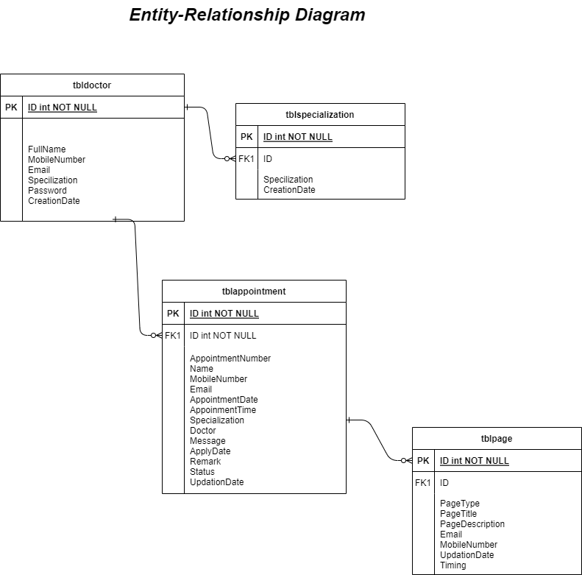
Entity-Relationship Diagram

Slide 12
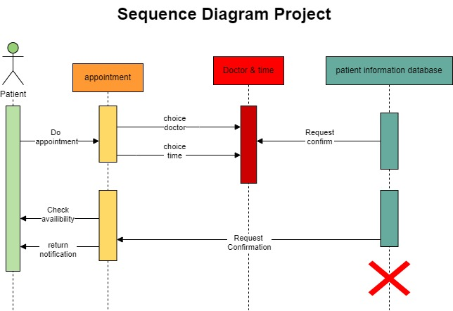
Sequence Diagram.

Slide 13
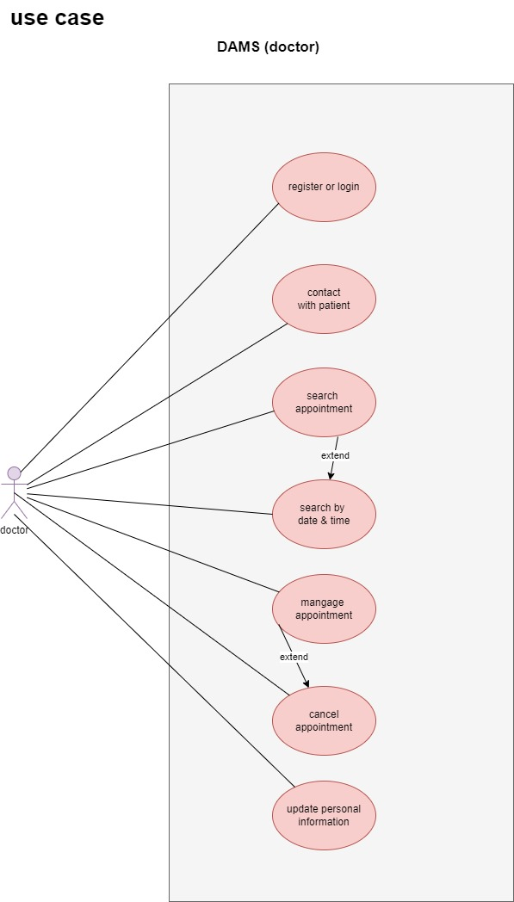
Use Case Diagram (Doctor)

Slide 14
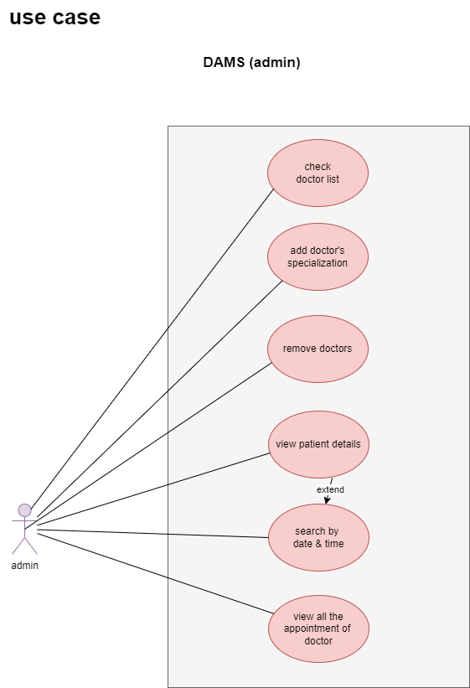
Use Case Diagram (Admin)

Slide 15
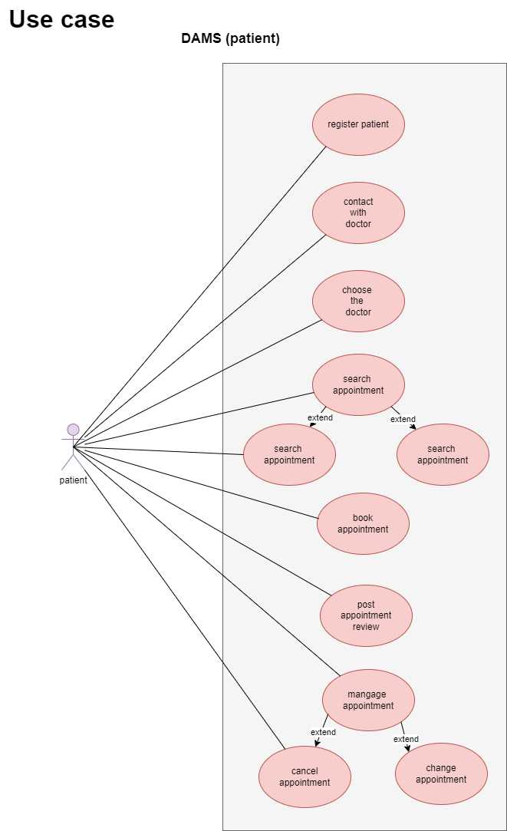
Use Case Diagram (Patient)

Slide 16
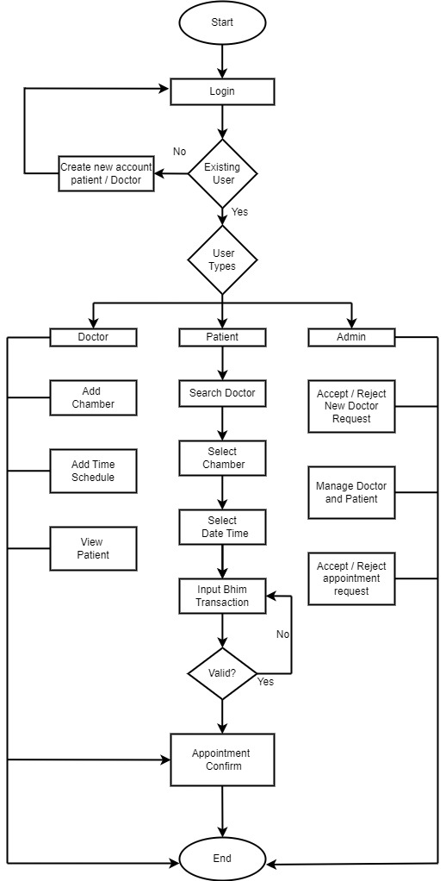
System Flow Diagram

Slide 17
Data Dictionary
Sr. No. | Field Name | Data Type | Size | Constraint | Description | Example
1 | Doctor -id | Int | 11 | Primary key, auto-increment | Unique identifier for each doctor | 100
2 | Name | Varchar | 100 | Not null | Name of the doctor | Dr.mehta
3 | email | Varchar | 100 | Null unique | Email address of the doctor | drmehta@gmail.com

Slide 18
Data Dictionary
Sr. No. | Field Name | Data Type | Size | Constraint | Description | Example
1 | Phone number | Varchar | 20 | null | Phone number of the doctor

Slide 19
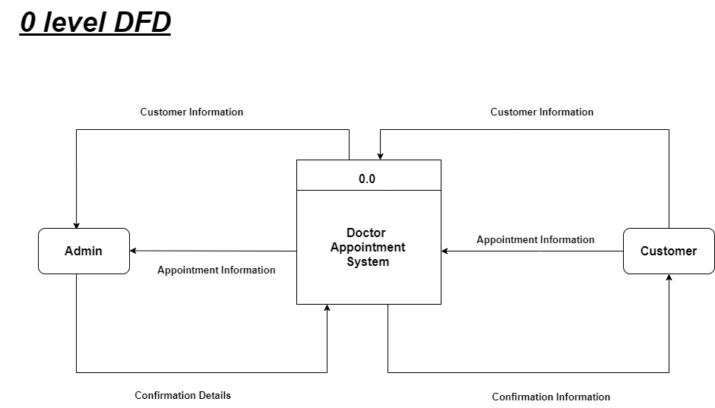
0 Level DFD

Slide 20
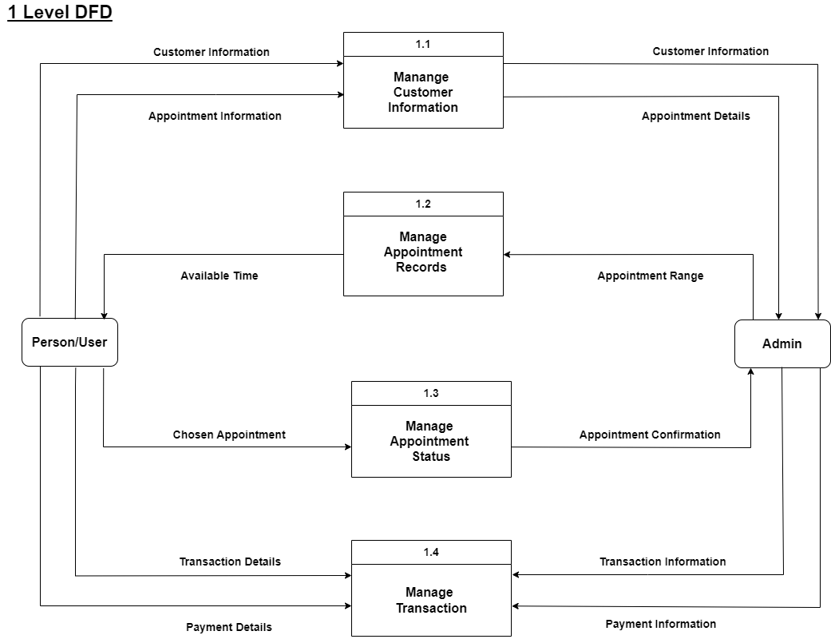
1 Level DFD

Slide 21
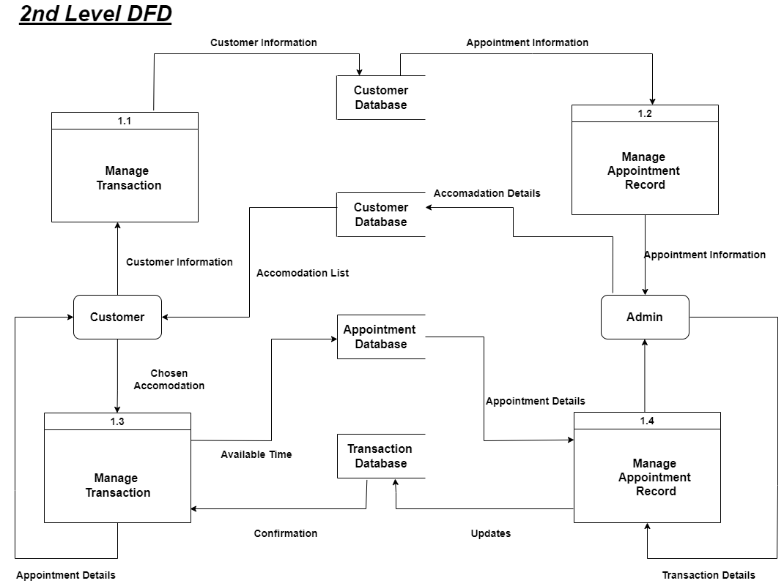
Level 2 DFD

Slide 22
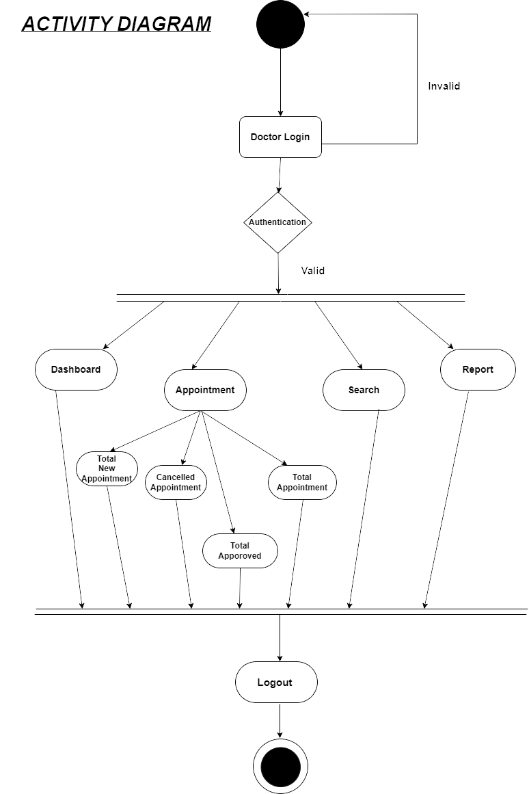
Activity Diagram

Slide 23
CONCLUSION:
In conclusion, a Doctor Appointment Management System developed using PHP can be an efficient solution for managing patient-doctor appointments.
With the help of this system, patients can easily book appointments with doctors, manage their appointments, and receive appointment reminders, while doctors can manage their appointment schedules and communicate with patients.
The system can also help to reduce administrative workload and increase the efficiency of the appointment booking process.
PHP is a popular and widely used web development language, which makes it a suitable choice for developing the Doctor Appointment Management System. It offers a wide range of features and tools that can be used to create a user-friendly and efficient system.
Overall, a Doctor Appointment Management System developed using PHP can benefit both patients and doctors by providing an easy-to-use and efficient system for booking appointments and managing schedules.

Slide 24


